Slide 1
Evaluate two models or theories of one cognitive process with reference to research studies.

Slide 2
Model 2: The Working Model of Memory Baddeley and Hitch 1974
Main argument was that Short Term Memory in the Multi-Store Model was much too simple (too passive).
They replaced STM with something they called Working Memory.

Slide 3
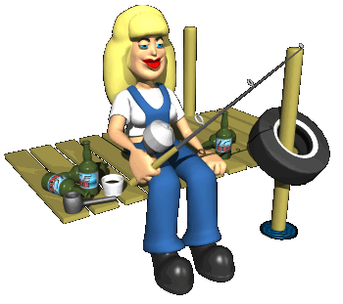
The Working Model of Memory Baddeley and Hitch 1974
Working Memory does not just sit there and take information.
Instead of all information going into one single store, there are different systems for different types of information.

Slide 4
The Working Model of Memory Baddeley and Hitch 1974
The Working Memory consisted of three main sections with a fourth added in 2000 by Baddeley.

Slide 5
The Working Model of Memory Baddeley and Hitch 1974
The Central Executive
Drives the whole system (e.g. the boss of working memory) and allocates data to the subsystems .
Like the Fat Controller from Thomas the Tank Engine.
Sends info to the other “slave” systems.

Slide 6
The Working Model of Memory Baddeley and Hitch 1974
The Phonological Loop
Handles verbal and auditory information.
Divided into two parts
Articulatory control process (inner voice) Linked to speech production. Used to rehearse and store verbal information from the phonological store.
Phonological Store (inner ear) Linked to speech perception Holds information in speech-based form (i.e. spoken words) for 1-2 seconds.

Slide 7
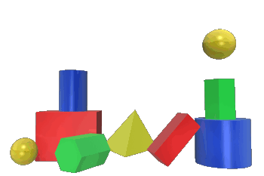
The Working Model of Memory Baddeley and Hitch 1974
The Visuo-Spatial Sketch Pad
(inner eye)
This is believed to hold visual information.
The eyes are used to store and manipulate visual and spatial information such as remembering colors or shapes.
Also used for navigation.

Slide 8
The Working Model of Memory Baddeley and Hitch 1974

Slide 9
Evidence that the WMM is the real deal.
The WMM helps explain real life problems. Like why we cannot process written and verbal information at the same time.
PET scans show evidence of separate components of STM as different areas are activated during different tasks.
KF Case Study

Slide 10
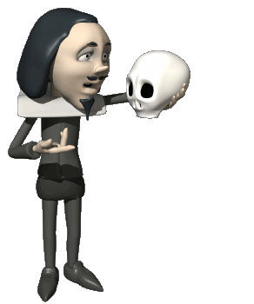
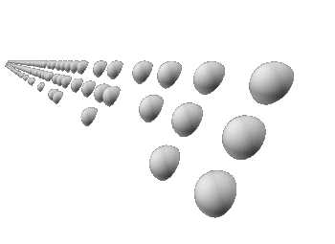
A study that proved the Working Model of Memory Quinn and McConnel (1996)
They asked participants to memorize a list of words by using either imagery or rehearsal.
The task was performed on its own or with a concurrent visual noise (changing patterns of dots) or a concurrent verbal noise (speech in a foreign language).

Slide 11
Quinn and McConnel (1996)
The results showed that learning by imagery was not affected by a concurrent verbal task
but was disturbed by a concurrent visual task.
The opposite was found in the rehearsal condition.

Slide 12
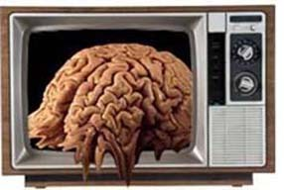
Quinn and McConnel (1996)
This indicates that imagery processing uses the Visuo-Spatial Sketch Pad whereas verbal processing uses the Phonological Loop.
If the two tasks used the same component, performance deteriorated.
The study this lends support to different “slave” systems of memory.

